Slide 2
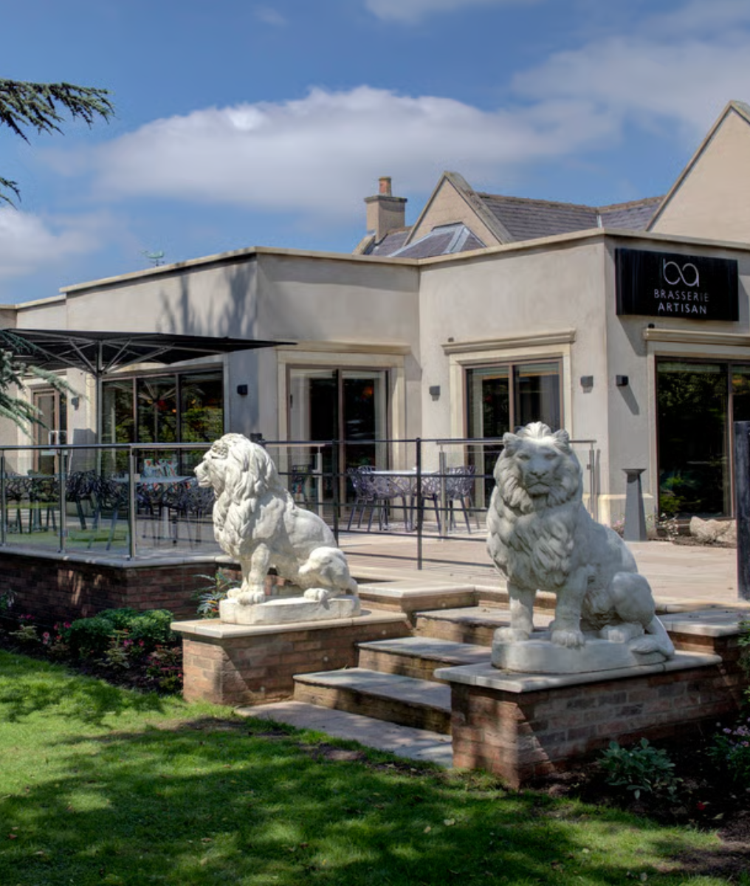
BWH Hotels GB
Media Pack
2026

Slide 3
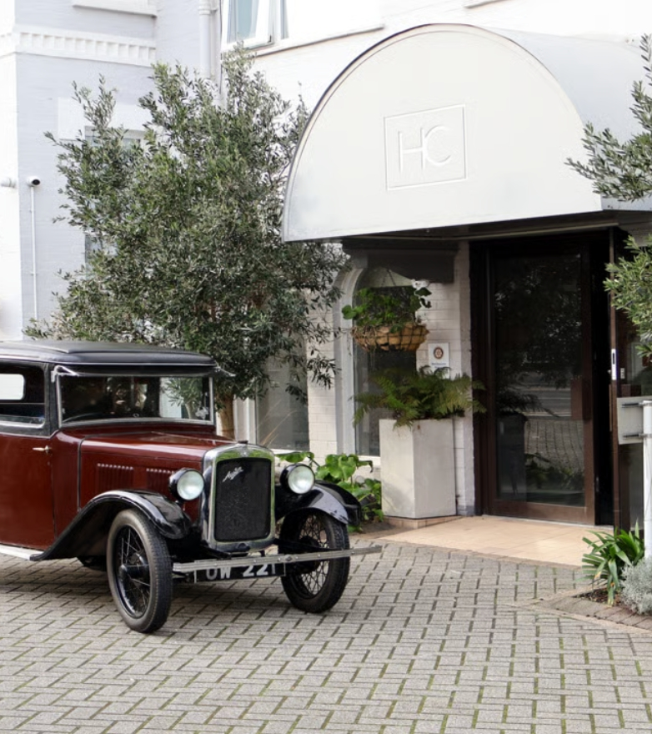
Unlock Opportunities with BWH Hotels GB
At BWH Hotels GB, we represent the largest group of independent hotels in Great Britain (220+) meaning we understand the unique needs and challenges they face daily. Our reach touches every corner of the industry, offering access to decision makers; from Owners to General Managers to Sales, Marketing and Revenue Managers, enabling YOU to stand out in a competitive landscape. Partner with BWH Hotels GB and unlock the potential to reach industry leaders across hotels in GB.
Let's work together to create exceptional experiences and business opportunities in 2026 and beyond*

Slide 4
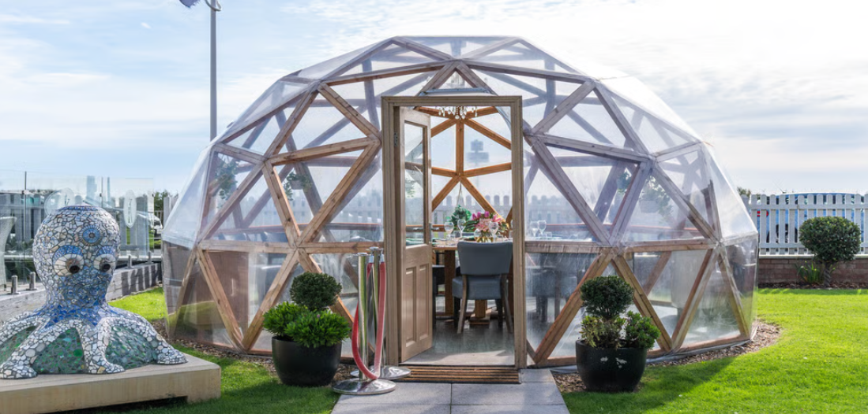
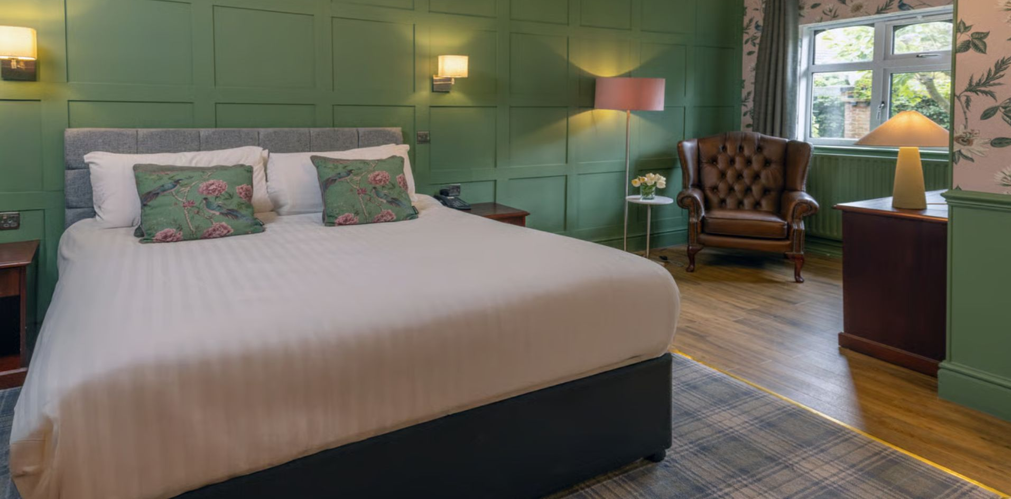
Why Work With Us?
1
Unmatched Reach and Influence
As the largest group of independent hoteliers in the UK, BWH Hotels GB offers unparalleled access to a diverse and extensive network of hotels. From operations to IT to marketing, our communications reach industry professionals working from the ground up to Exec level.
2
Trusted and Respected Brand
Globally, BWH Hotels was founded in 1946 by M.K. Guertin, a hotelier who started the company as an informal referral system among member hotels. Over the years, it has grown into one of the world's largest collections of independent hotels, with over 4,200 hotels in more than 100 countries, across 19 brands. By aligning your brand with ours, you gain instant credibility within the hospitality industry.

Slide 5
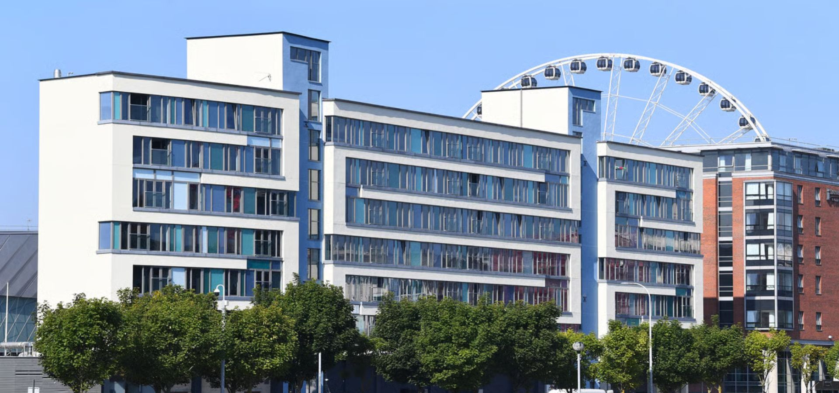
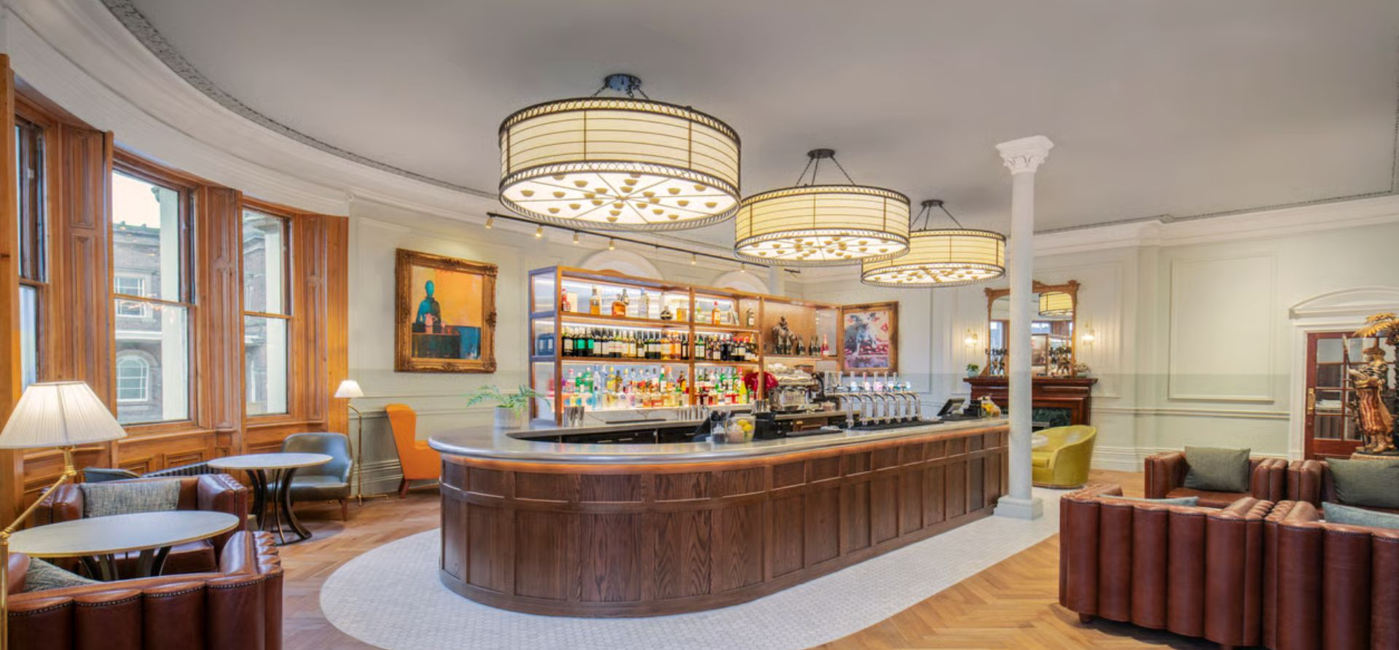
What Makes Us Different?
4
Sustainable Credentials
At BWH Hotels GB, we are committed to sustainability and responsible business practices. Partnering with us means aligning with a brand that values and promotes environmental and social responsibility at a time when it matters.
3
Industry Leading Experts
From our SEO strategy to our sales and revenue champions, our team are our biggest strength with serious persuasion power amongst our hoteliers. Whether you’re looking to upsell guest software or influence F&B purchasing, our team can help to tailor your communications to best suit our hoteliers’ needs.

Slide 6
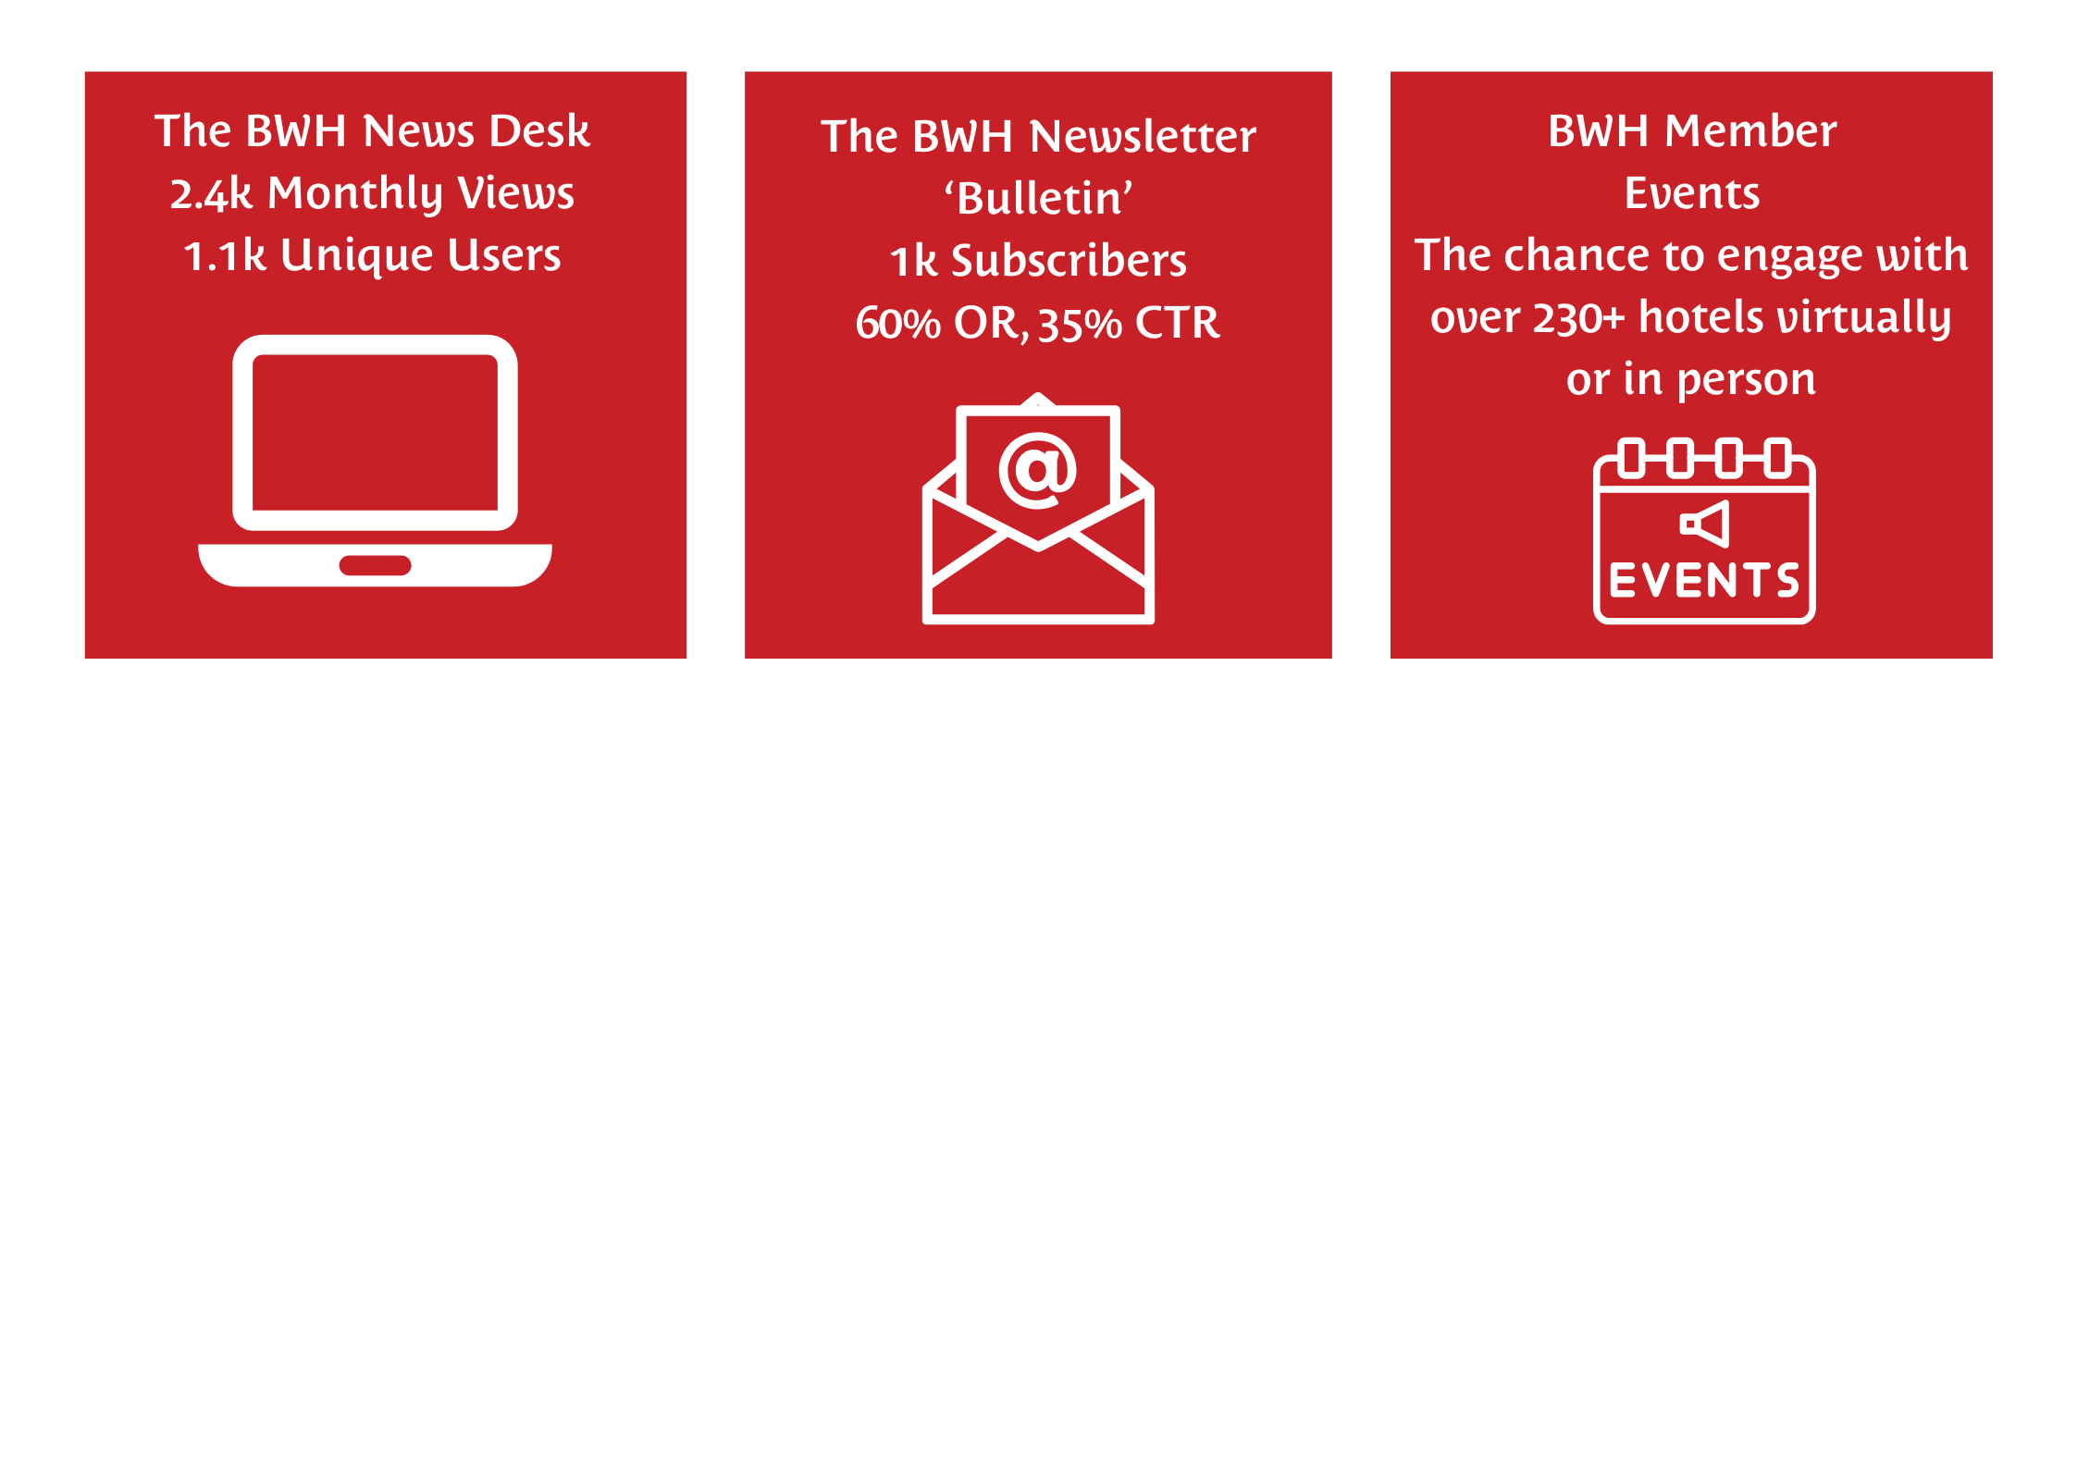
Our Channels At A Glance

Slide 7
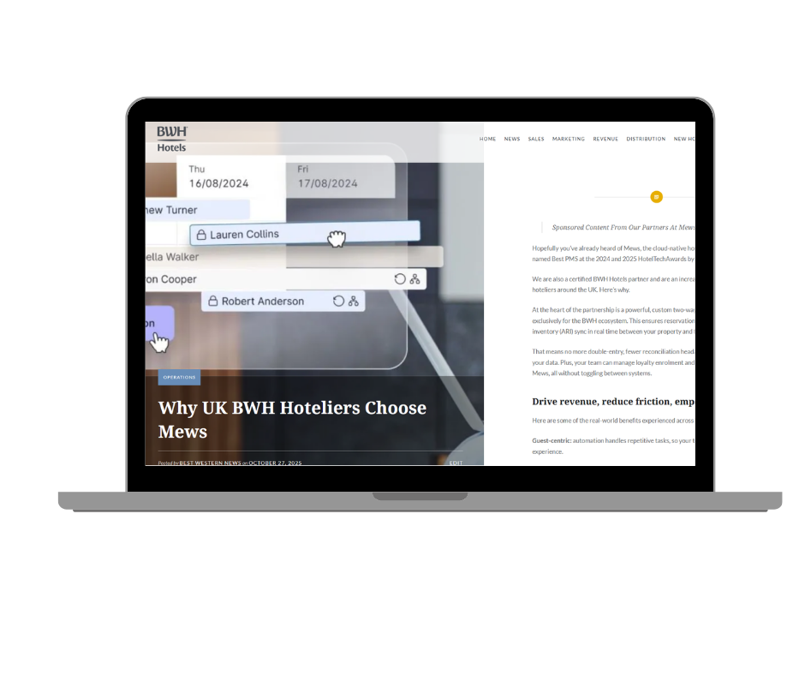
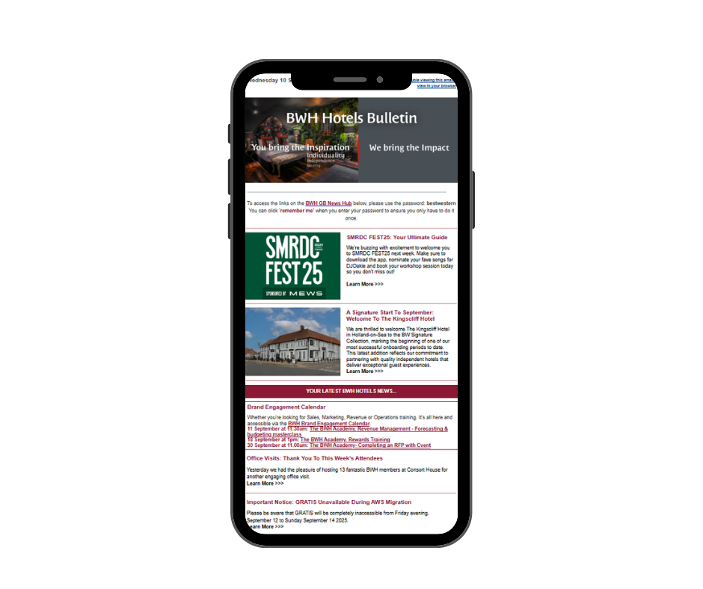
The BWH News Desk
Accessible only to members (password protected)
2.5k monthly views
1.1k monthly unique users
A mix of GMs, Sales, Marketing, Revenue professionals and Owners
Media Options:
Sponsored Post with link to website
Promotion in weekly Bulletin newsletter (60% average open rate, 35% average click rate)
Live for a minimum of 6 months
£999 - Content is supplied by you with BWH approval
*Maximum of 2 campaigns per brands

Slide 8
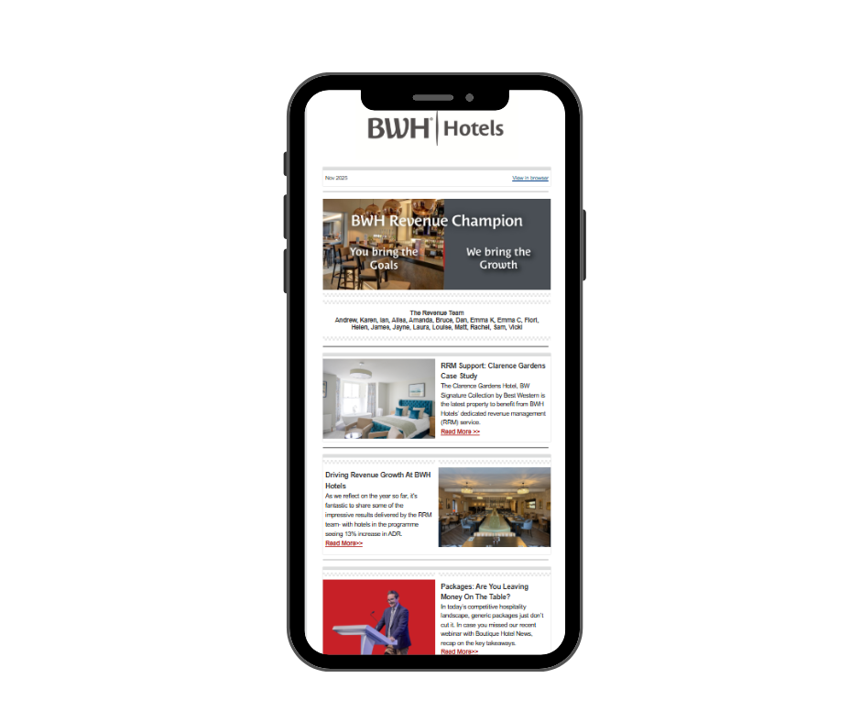
BWH Revenue
Champ
Sent quarterly to 300 Revenue Managers at BWH Hotels
4x opportunities per year
60% average open rate
Media Options:
Sponsored Solus
£500 - Content is supplied by you with BWH approval

Slide 9
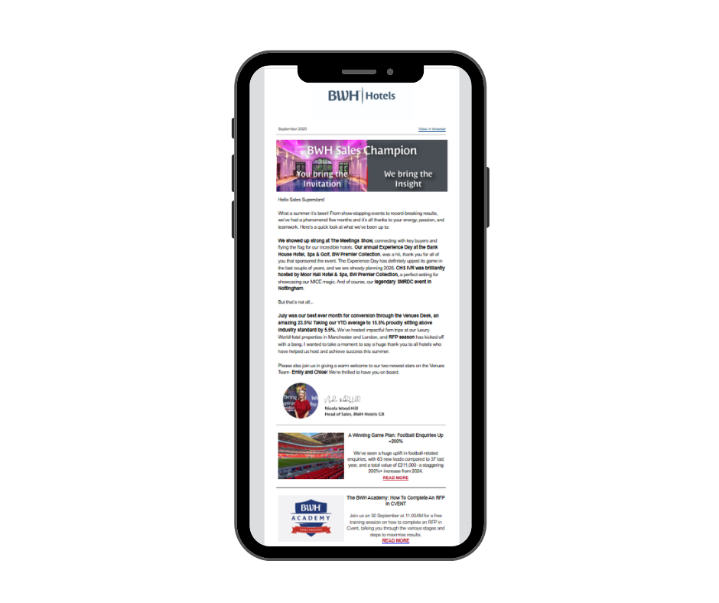
BWH Sales
Champ
Sent quarterly to 300+ Sales Managers at BWH Hotels
4x opportunities per year
70% average open rate
Media Options:
Sponsored Solus
£500 - Content is supplied by you with BWH approval

Slide 10
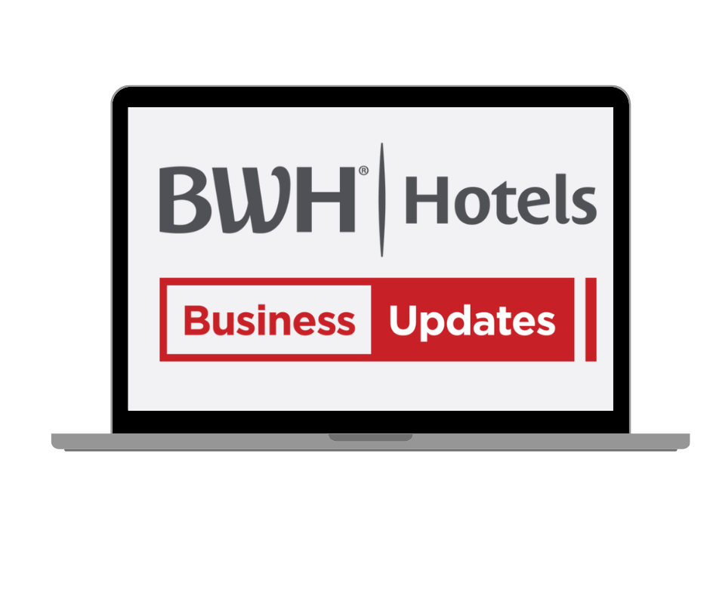
Virtual Business
Updates
A virtual business updates meeting open to all BWH Hotels Members
Average attendees: 250+ registrations
Hosted online, free for members to access with link to re-watch shared widely
MEDIA OPTIONS:
EVENT SPONSOR: £2000 per event
Join us virtually for one of two business updates meetings in 2026 (May & September)
A 10-minute company presentation virtually
Company profile and logo on event registration site
Company mentioned throughout the meeting
1 x company dedicated solus email to our database
Opportunity for lead generation or data capture to be agreed on case-by-case basis

Slide 11
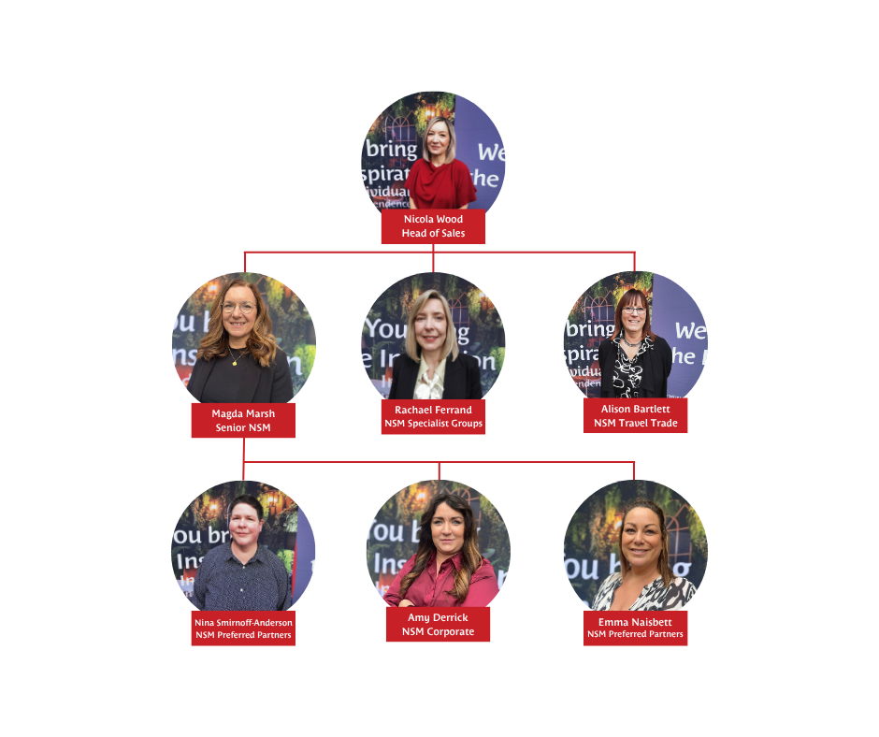
MEET THE SALES
MANAGERS
Get your brand seen at our 'Meet The Sales Managers' in person events x3
Attendees include BWH GM's, Owners, Senior Leaders
MEDIA OPTIONS
Hero Sponsor: £2000
Includes:
Exclusive to one company (for each event)
Network one on one with BWH hotels insiders
Company branding in the meeting room
Company logo on all event comms
Company mentions in all event comms
One dedicated email to all Sales Champs at BWH Hotels (sent to 322 contacts/70% open rate)
Company mentions on our post event LinkedIn post
10 minute presentation/speech during lunch
*Suitable for brands looking to target sales professionals within hotels

Slide 12
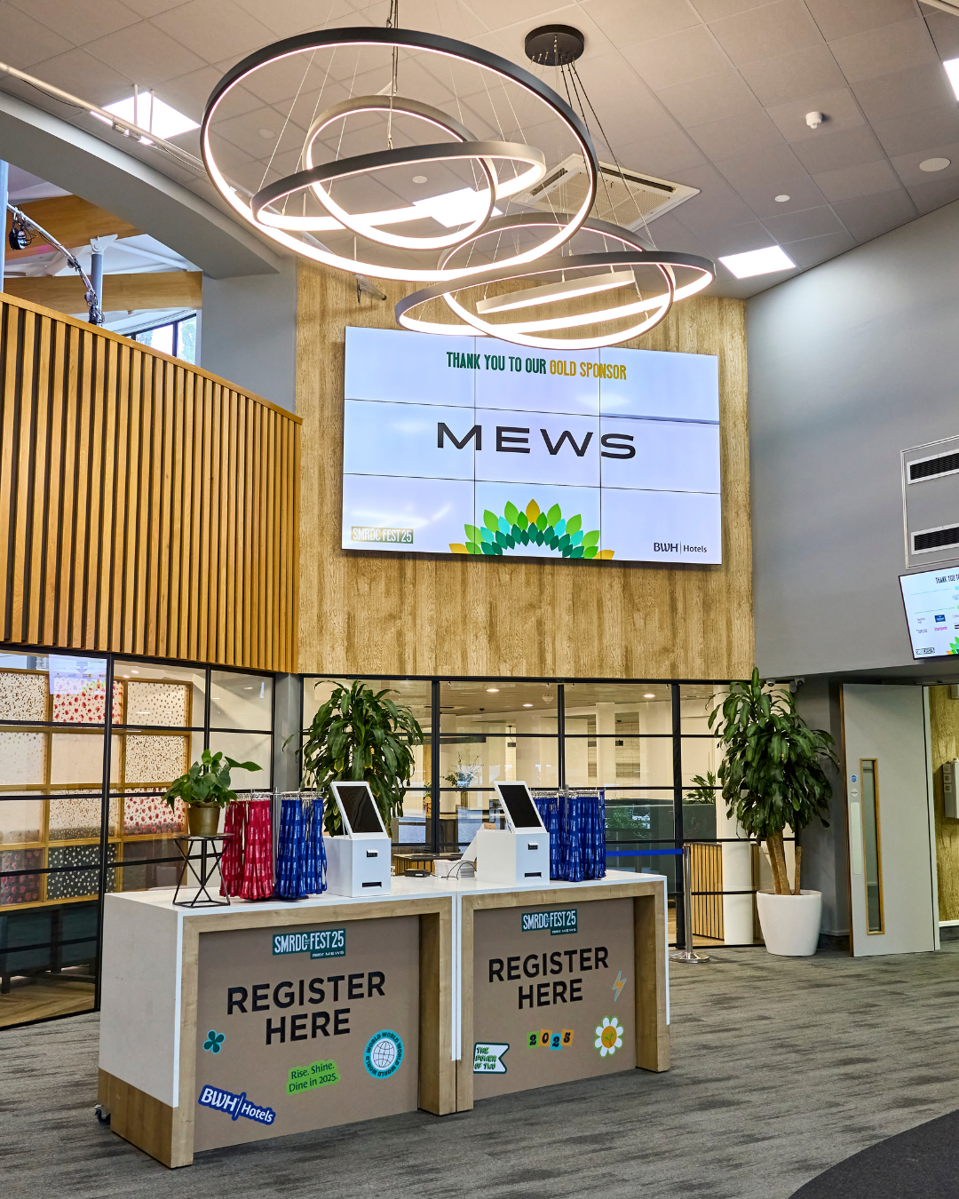
SMRDC FEST26
Get your brand seen at our annual Sales, Marketing, Revenue & Distribution conference.
Delegates: 200+
November 2026
Venue: TBC
MEDIA OPTIONS
GOLD SPONSOR: £5000
Includes:
Masterclass host on mainstage
Exhibition stand (2x3m)
Company branding pre, during and post event
2x solus emails to member database
Sponsored table at evening dinner
Delegate data download

Slide 13
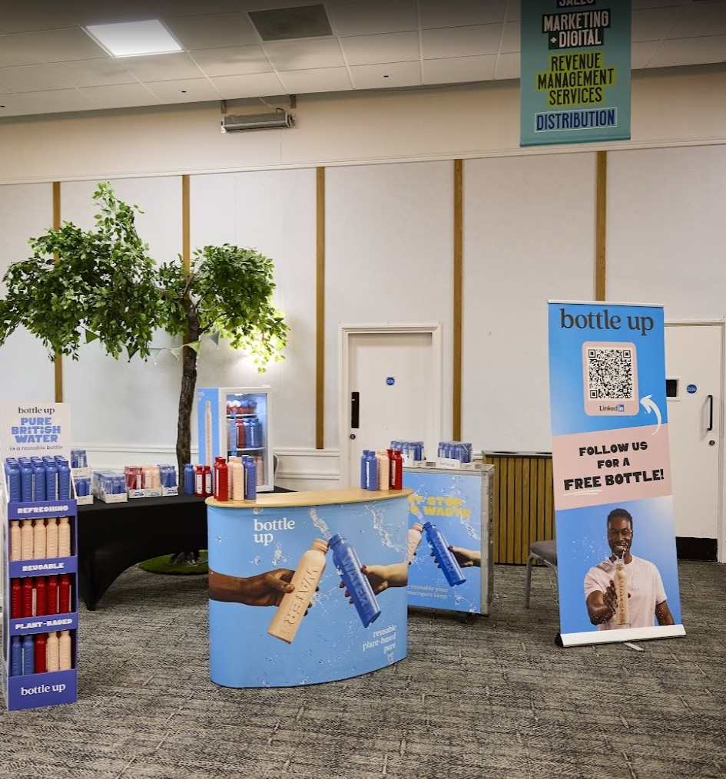
SMRDC FEST26
MEDIA OPTIONS
2x SILVER SPONSOR: £3000
Includes:
Masterclass host on mainstage
Exhibition stand (2x2m)
Company branding pre, during and post event
1x solus email to member database
Sponsored table at evening dinner
Delegate data download
BRONZE SPONSOR: £1500 (Multiple Available)
Includes:
Exhibition stand (tabletop style)
Company branding pre, during and post event
1x dinner ticket
Delegate data download

Slide 14
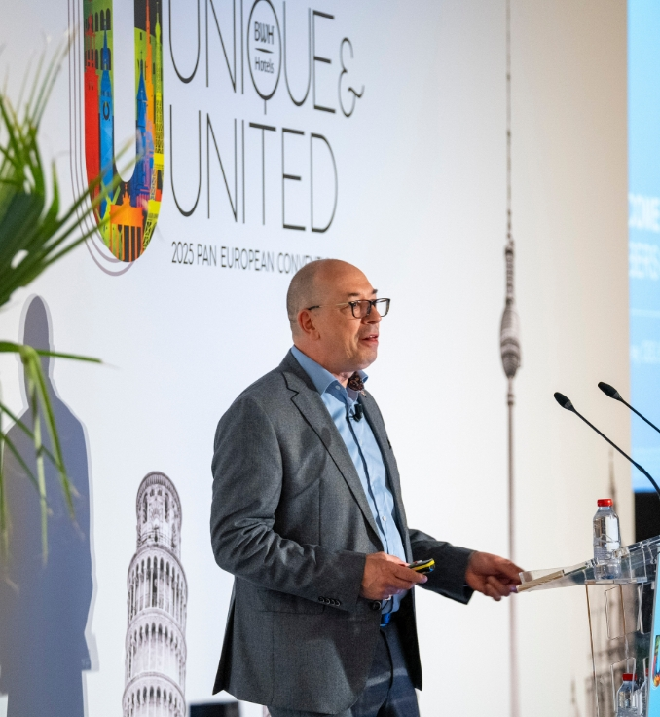
AMC SPRING 2027
Get your brand seen at our Annual Members’ Conference, Spring 2027.
Sponsor slots for 2026 are now all SOLD OUT. Get in touch to register your interest for 2027.
Delegates: 250+ owners/decision makers
We have various sponsor packages available including:
GOLD SPONSOR: £15,000
GALA DINNER & HOTEL OF THE YEAR SPONSOR: £6000
WELCOME EVENING SPONSOR: £4000
KEYNOTE SPEAKER SPONSOR: £2500
LUNCH & REFRESHMENT BREAK SPONSOR: £2000
EXPO STAND: £1500

Slide 15
Want to work with us? Our hotel communications team would love to discuss your goals and objectives. If you're looking to reach industry leaders in hospitality, with dynamic communications that will resonate, get in touch today:
Rachel Jackson & Jo Hogg
Communications@BWHHotels.co.uk
Please note – this is a sponsorship agreement and not an endorsed supplier listing. All sponsorship requests subject to approval from the Senior Leadership Team at BWH Hotels.

